Slide 1
Weekly Photography Assignment One
By: Joanna Umosella

Slide 2
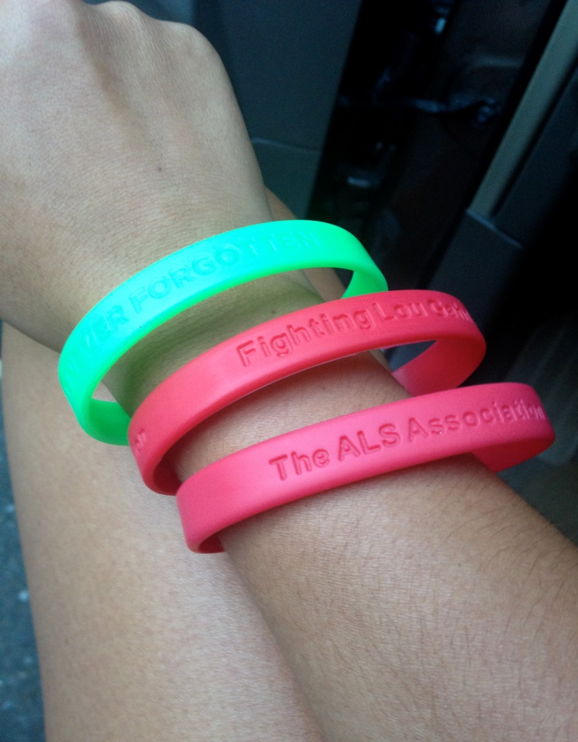
Subject. My wrist and the bracelets are the main subject of this photo.

Slide 3
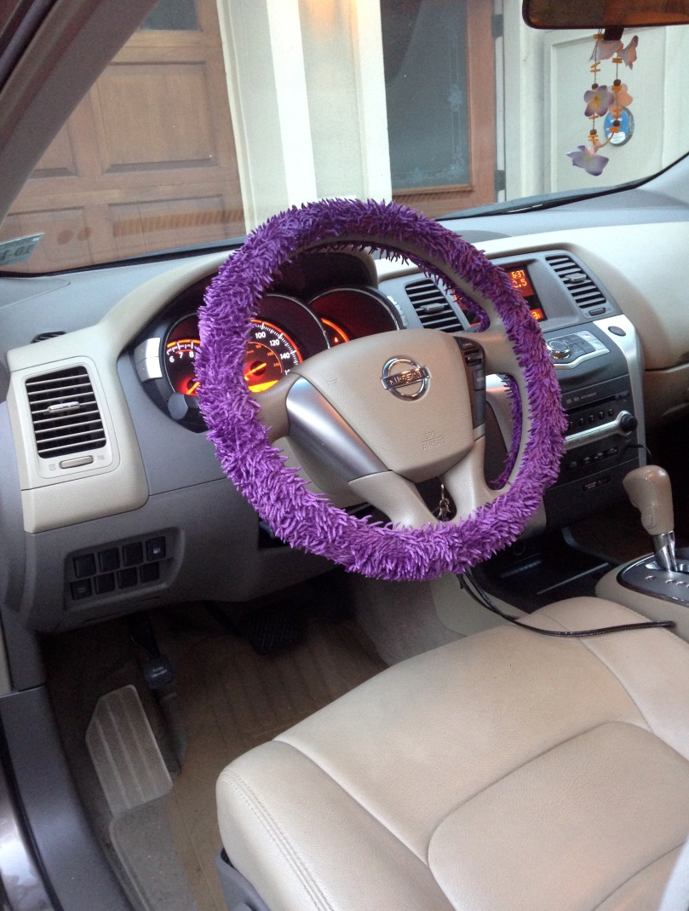
Focus. The picture focuses on the steering wheel and that is what should get your attention

Slide 4
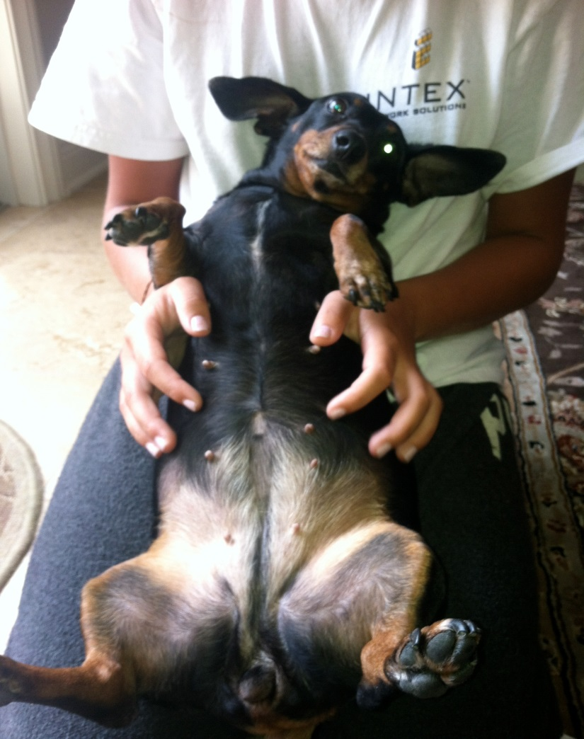
Subject. My dog is the main subject in the photo.

Slide 5
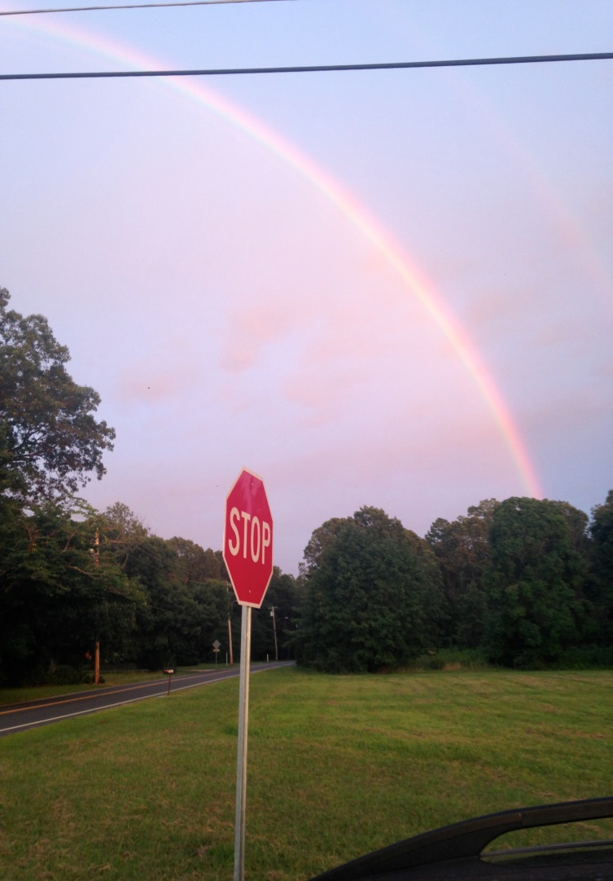
Background&foreground. The stop sign is the foreground and the rainbow is the background.

Slide 6
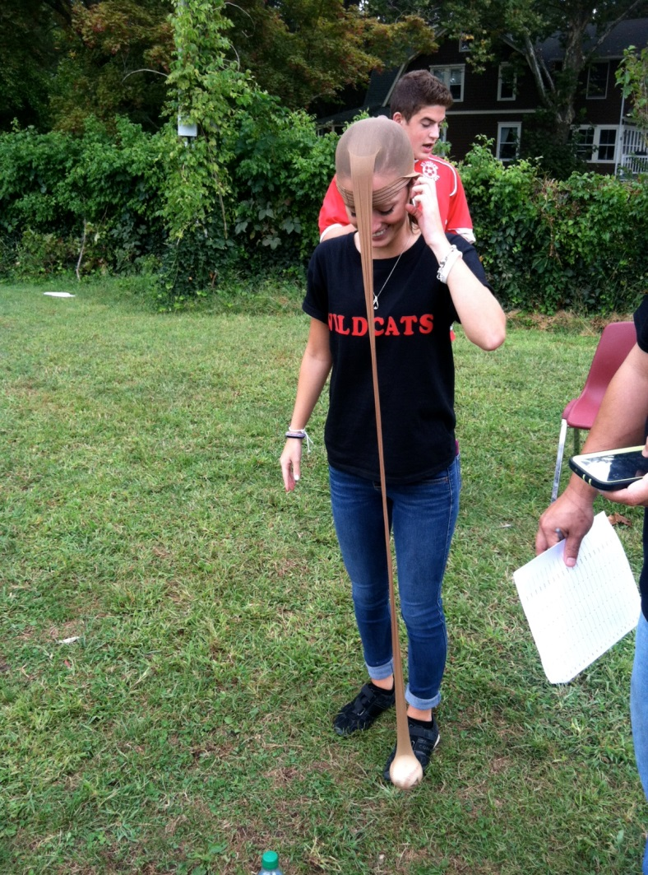
The Rule of thirds

Slide 7
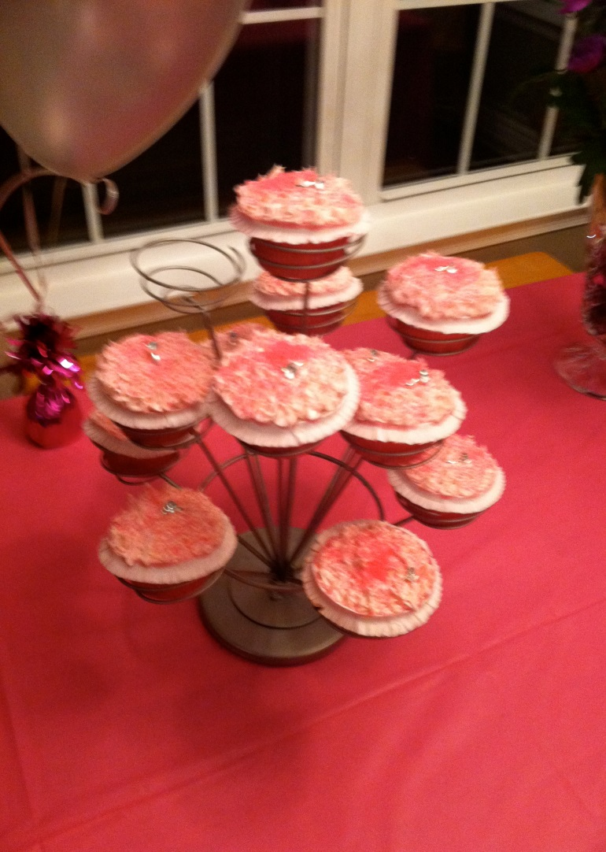
Color,background and foreground. Color; the different colors of the cupcakes (white, pink and glitter), the red tablecloth would be the background and the pink cupcakes would be the foreground.

Slide 8
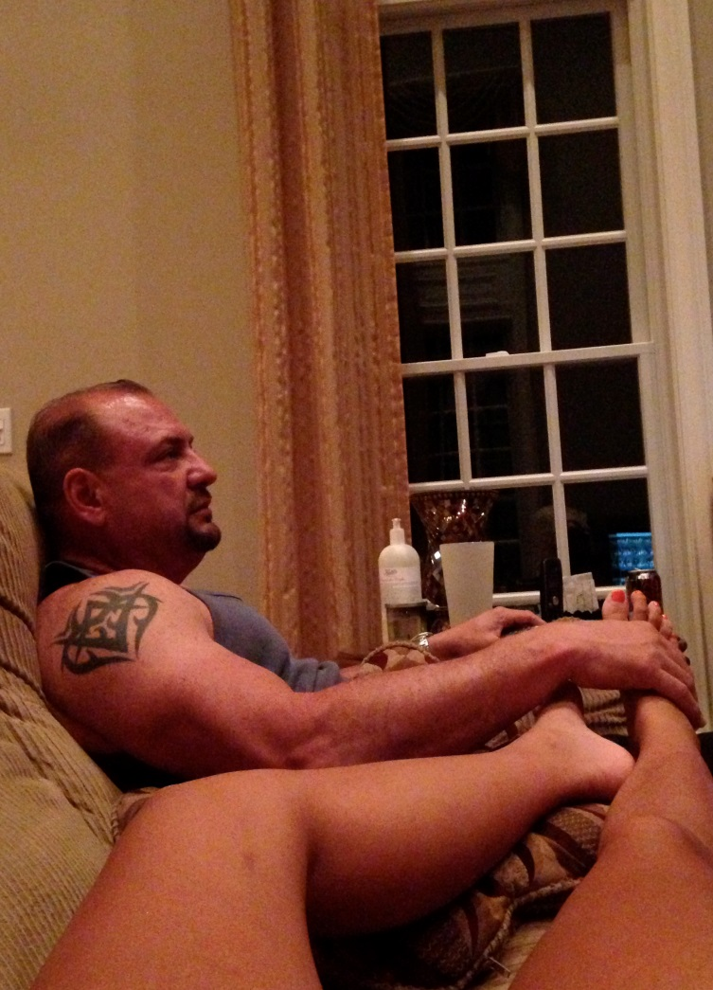
Foreground and background. My dad would be the background and my legs would be the foreground.

Slide 9
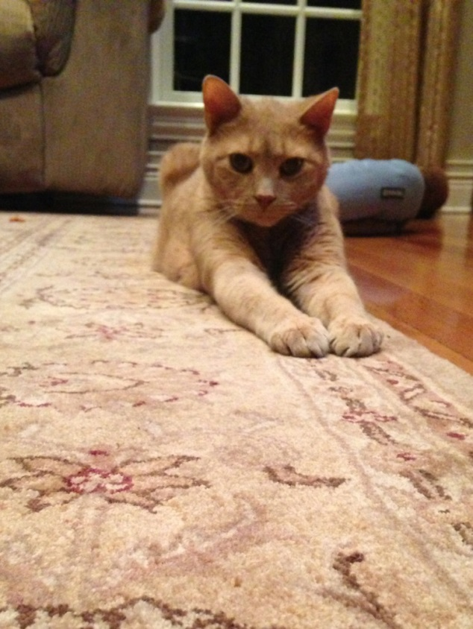
Rule of thirds and subject. My cat is the main subject.

Slide 10
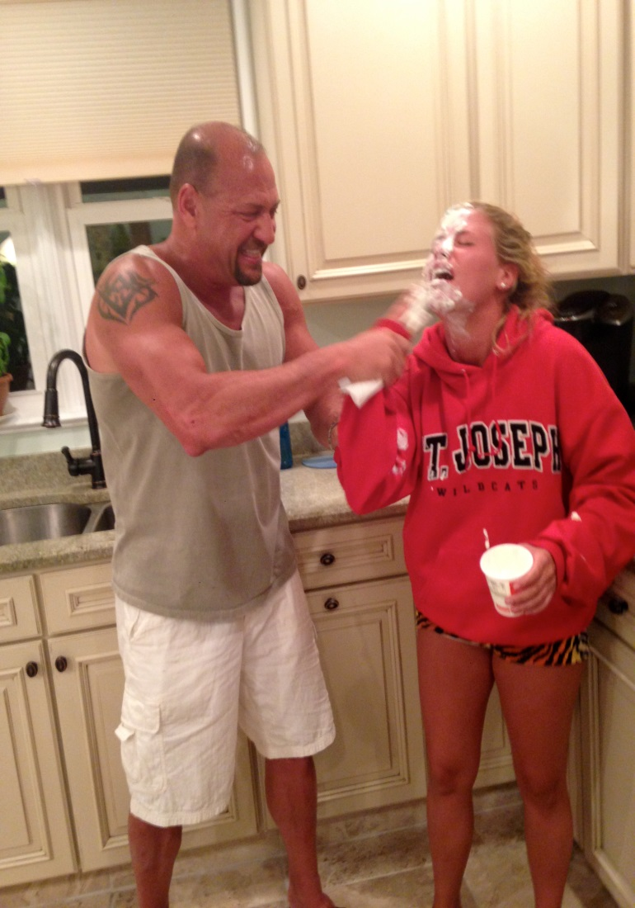
Motion. The action taking place is my sisters hand whipping off sour cream and also my dad laughing.

Slide 11
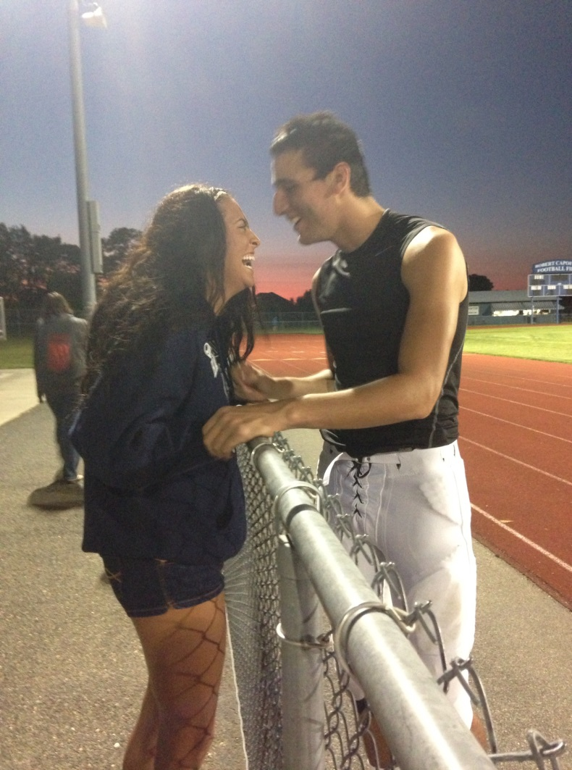
Foreground & background,and motion. The laughing is the motion. The sky and the field are the background.

Slide 12
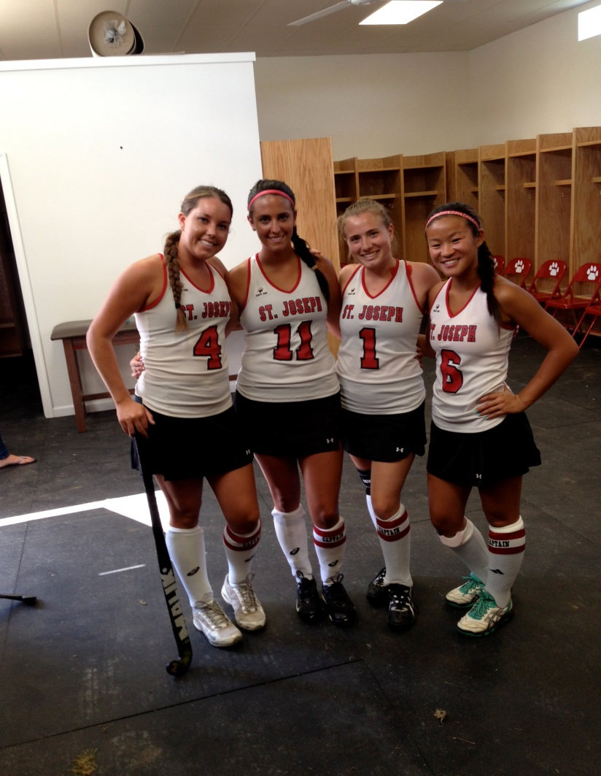
Subject. The four of us captains are the main subject of the picture.

Slide 13
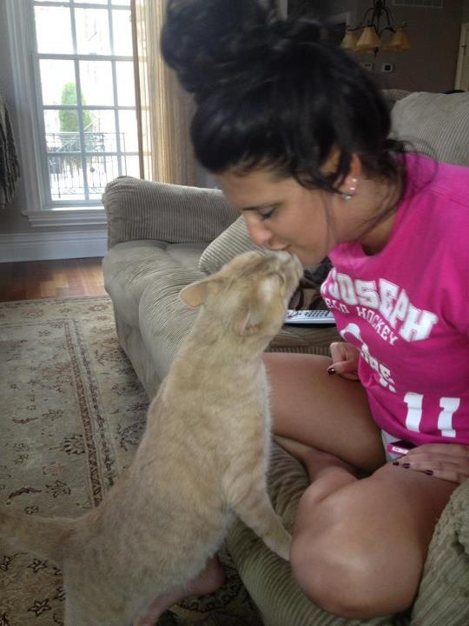
Motion. My cat kissing me is the motion used in the picture.

Slide 14
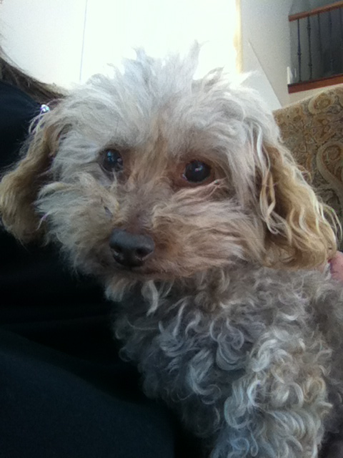
Subject.

Slide 15
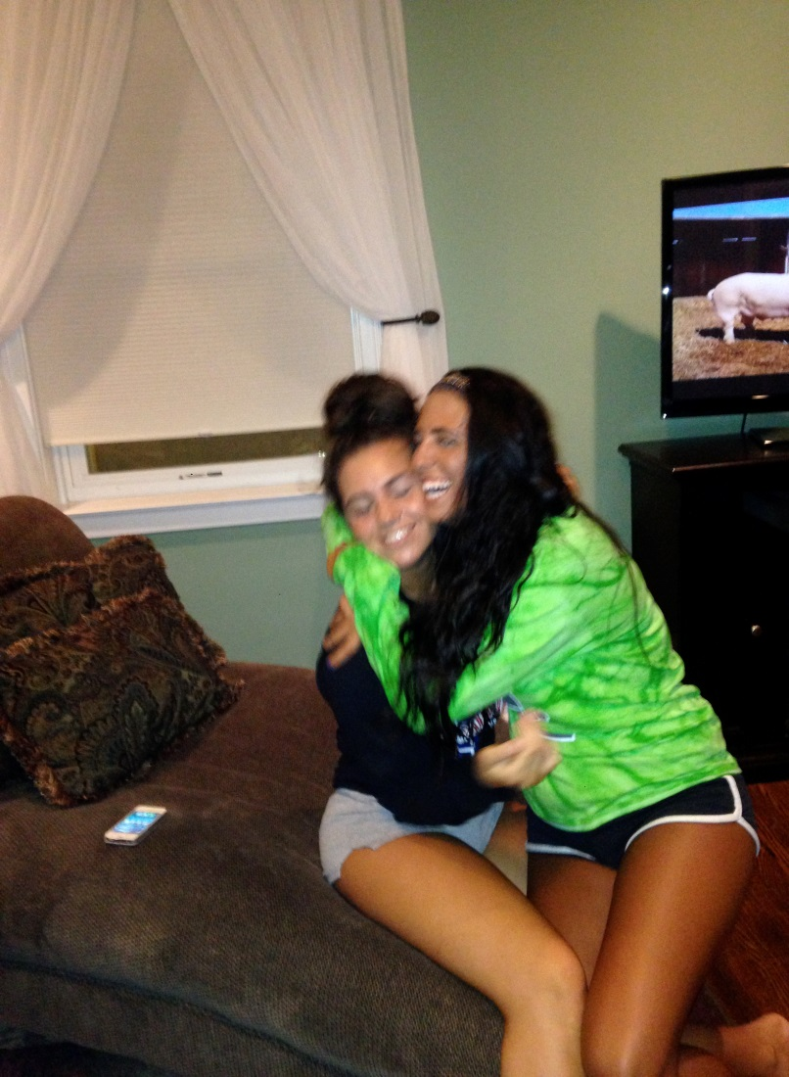
Motion

Slide 16
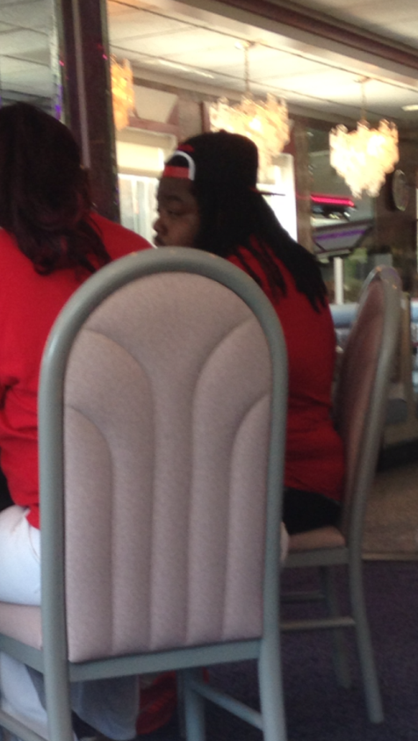
Foreground & background. The chair is the foreground and the guy that looks like the guy on vine is the background.

Slide 17
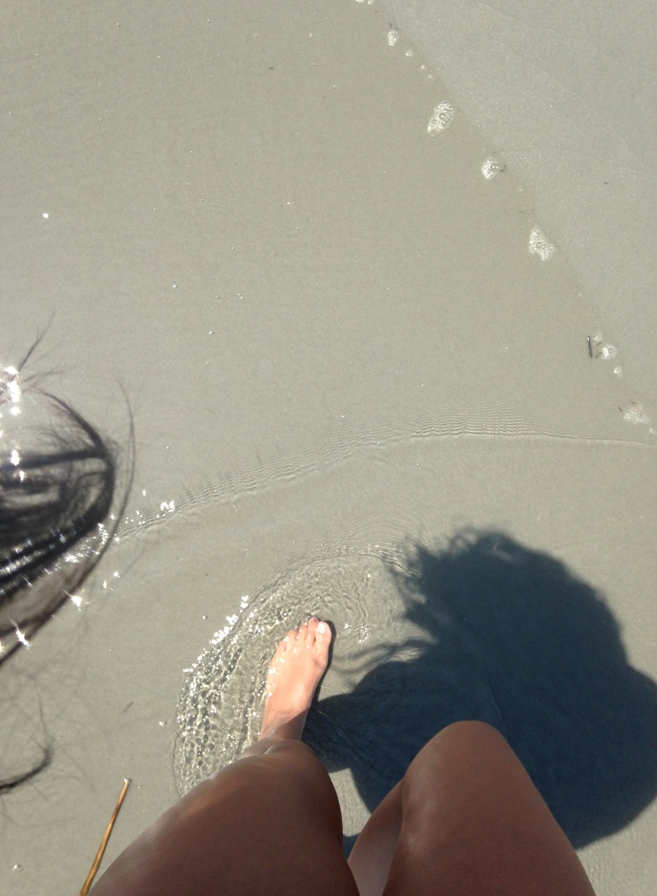
Lighting. The way the sun was hitting created a shadow of myself on the ground.

Slide 18
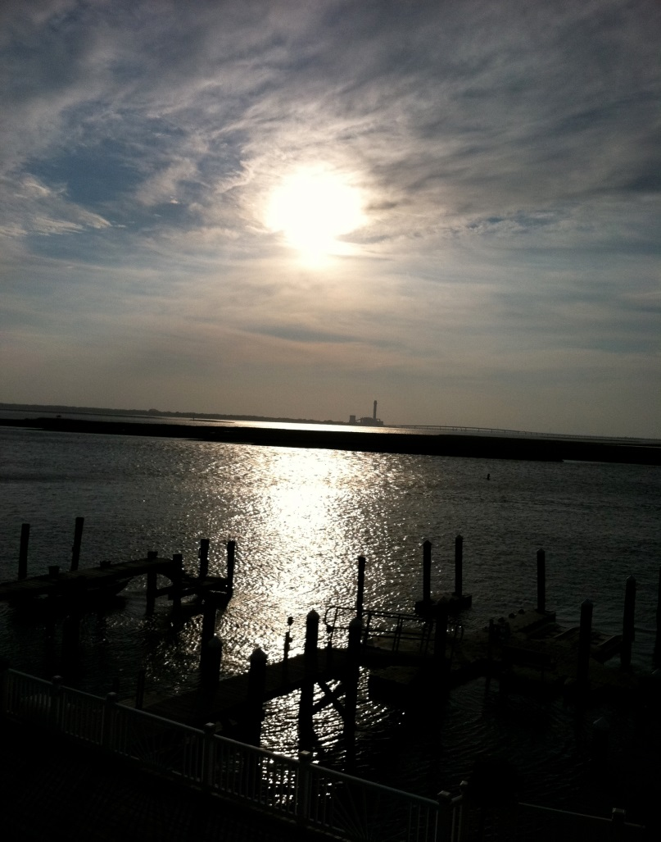
Lighting, foreground&background. The lighting would be the sun reflecting off the water. The foreground would be the dock and the water. The background would be the sky and the sunset.

Slide 19
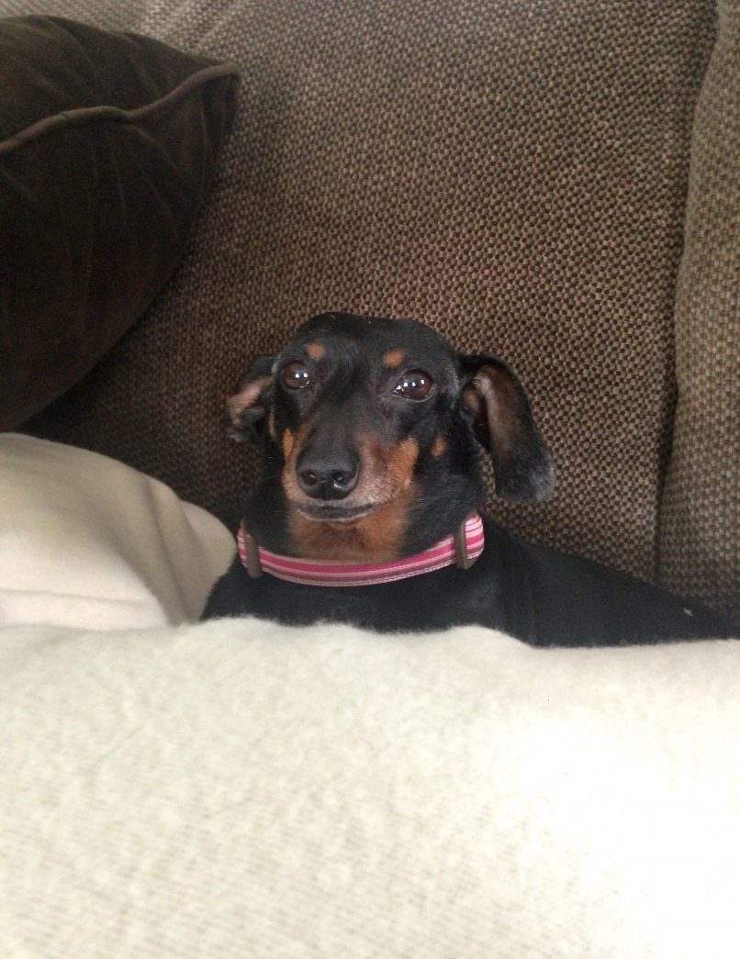
Focus and subject. I focused on my dog making it stand out. Also, she is the main subject in the photo.

Slide 20
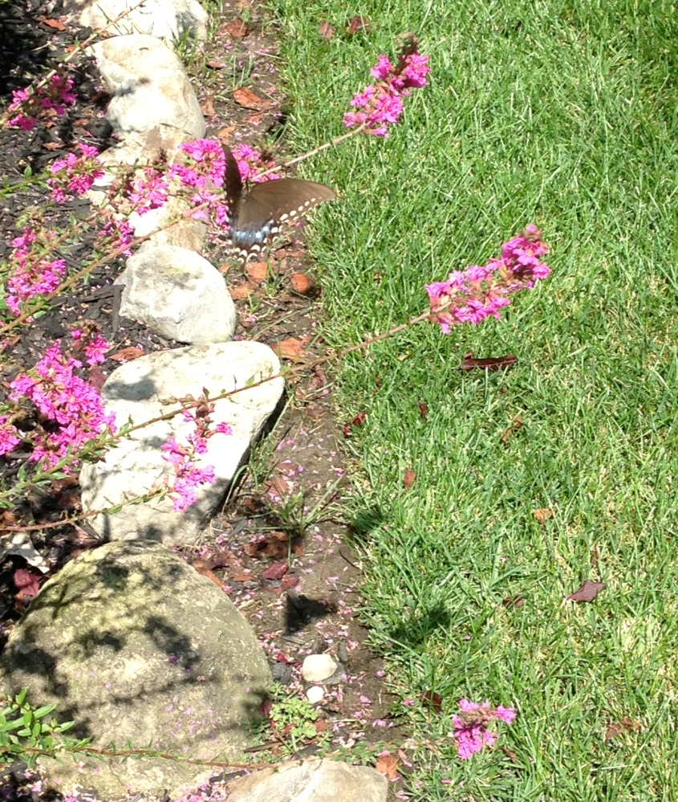
Lighting and focus. The lighting would be the shadows of the flowers. The focus is the flowers and the butterfly on the one flower.

Slide 21
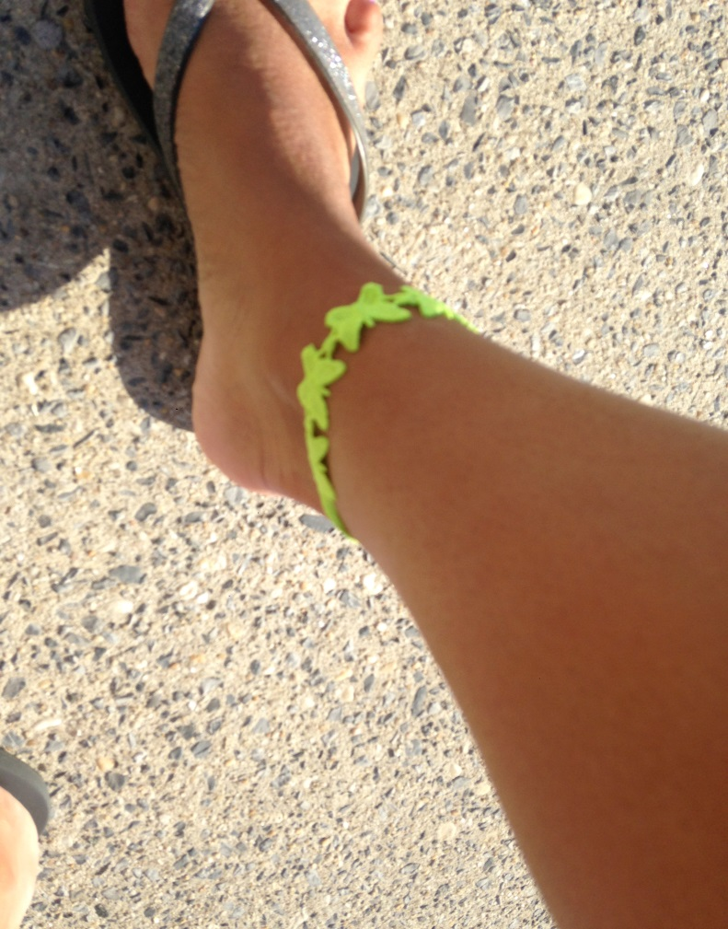
Color. The lime green coloring of the ankle bracelet stands out.

